Slide 1

Nike
Inside the Minds of Nike's Young Consumers: A Marketing Research Study
MKT 5401-01
Instructor: Prof. Ozlem Hesapci Karaca
Team 5
Akancha Poddar
Hao Tan
Harshini Nagaraju
Mihir Mahendra Koyande
Yudong Zhao

Slide 2

SWOT Analysis of Nike
Strengths:
ØStrong brand reputation and recognition globally
•Diversified product portfolio, including a wide range of shoes, apparel, and accessories for different sports and activities.
•Strong marketing campaigns and endorsements from high-profile athletes and celebrities
Weaknesses:
ØCriticism regarding labor practices in overseas factories
ØHigher prices compared to competitors, which may limit market share in certain segments
ØDependence on third-party manufacturers, which can impact quality and supply chain management
Opportunities:
ØGrowth in e-commerce and online sales, which can expand the reach of the brand globally
ØPartnership opportunities with technology companies to integrate wearable technology into products
Threats:
ØIntense competition from other athletic apparel and footwear brands, such as Adidas and Under Armour
ØPolitical and economic instability in overseas markets where Nike operates
ØConsumer trends and preferences shifting away from athletic wear and towards more casual styles.
Ø

Slide 3

Research Problem
•One potential research problem for Nike in the shoes and apparel industry could be how to create sustainable materials and production processes that reduce the company's environmental impact while still meeting consumer demand for high-quality products.
•Another research problem could be how to use technology to enhance the performance and functionality of Nike products. This could involve researching new materials and designs that improve comfort, support, and durability, as well as incorporating technology such as sensors or data analysis to help athletes optimize their training and performance.
•Additionally, Nike could research how to effectively market and distribute their products to different target audiences. This could involve conducting market research to understand consumer preferences and trends, as well as developing targeted marketing campaigns and distribution strategies to reach specific demographics, such as younger or more environmentally conscious consumers.
•

Slide 4
Hypothesis

Slide 5
Methodology
Dependent Variable - overall satisfaction level of customers for a Nike apparels.
Independent Variables – a) Buy for Fashion b) design c)Price

Slide 6
Methodology
Design and Procedure -Questionnaire
Sample ●Target audience ●
Method of sampling - stratified
Instruments ● Likert scale & Netpromoter score
● Analysis tools- SPSS ●
Questionnaire- Clark Qualtrics

Slide 7
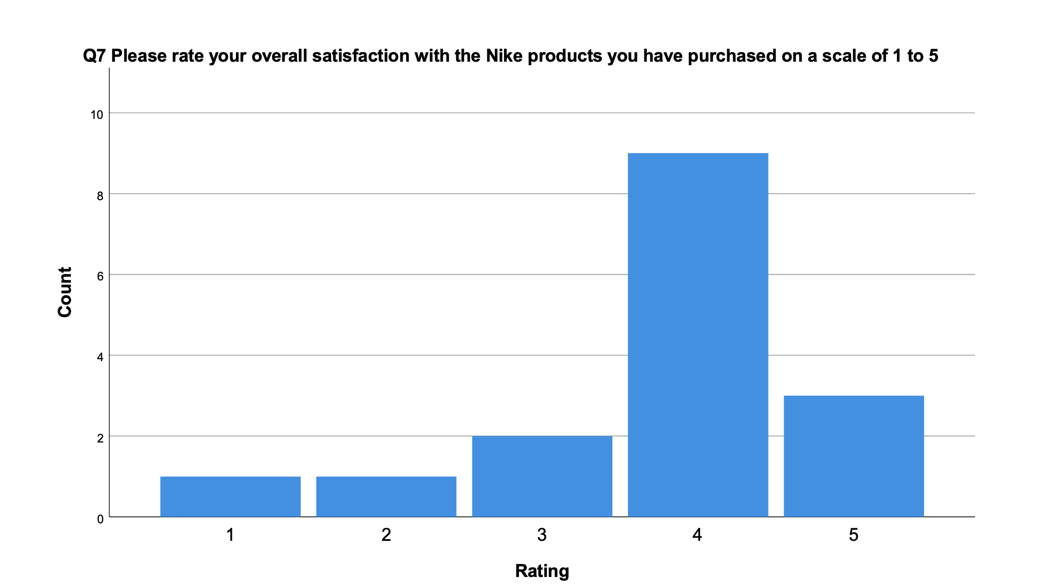
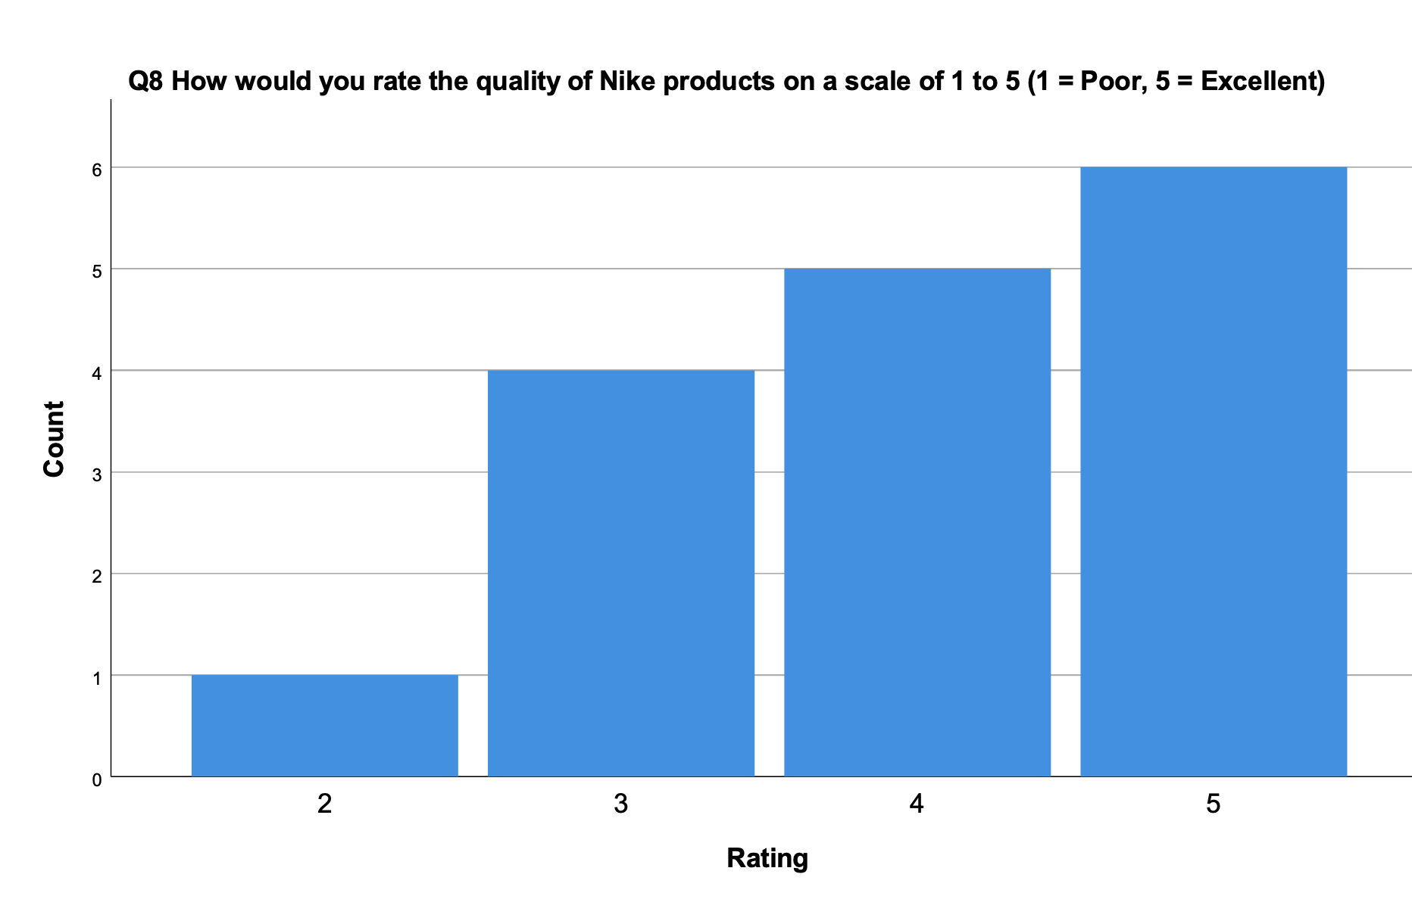
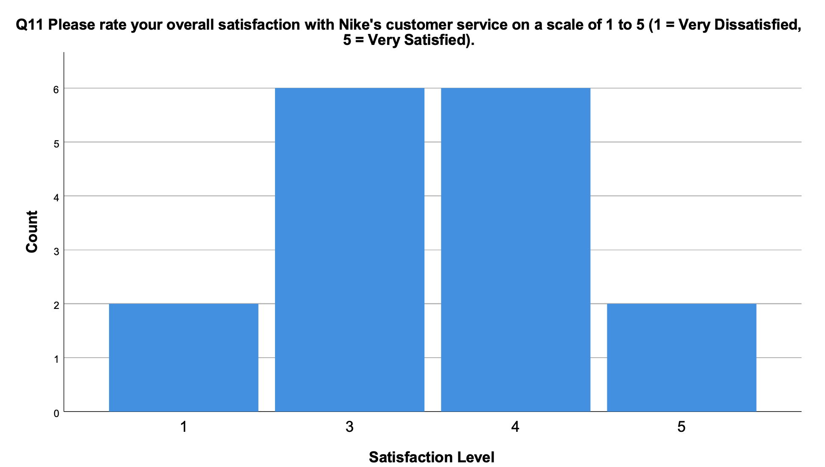
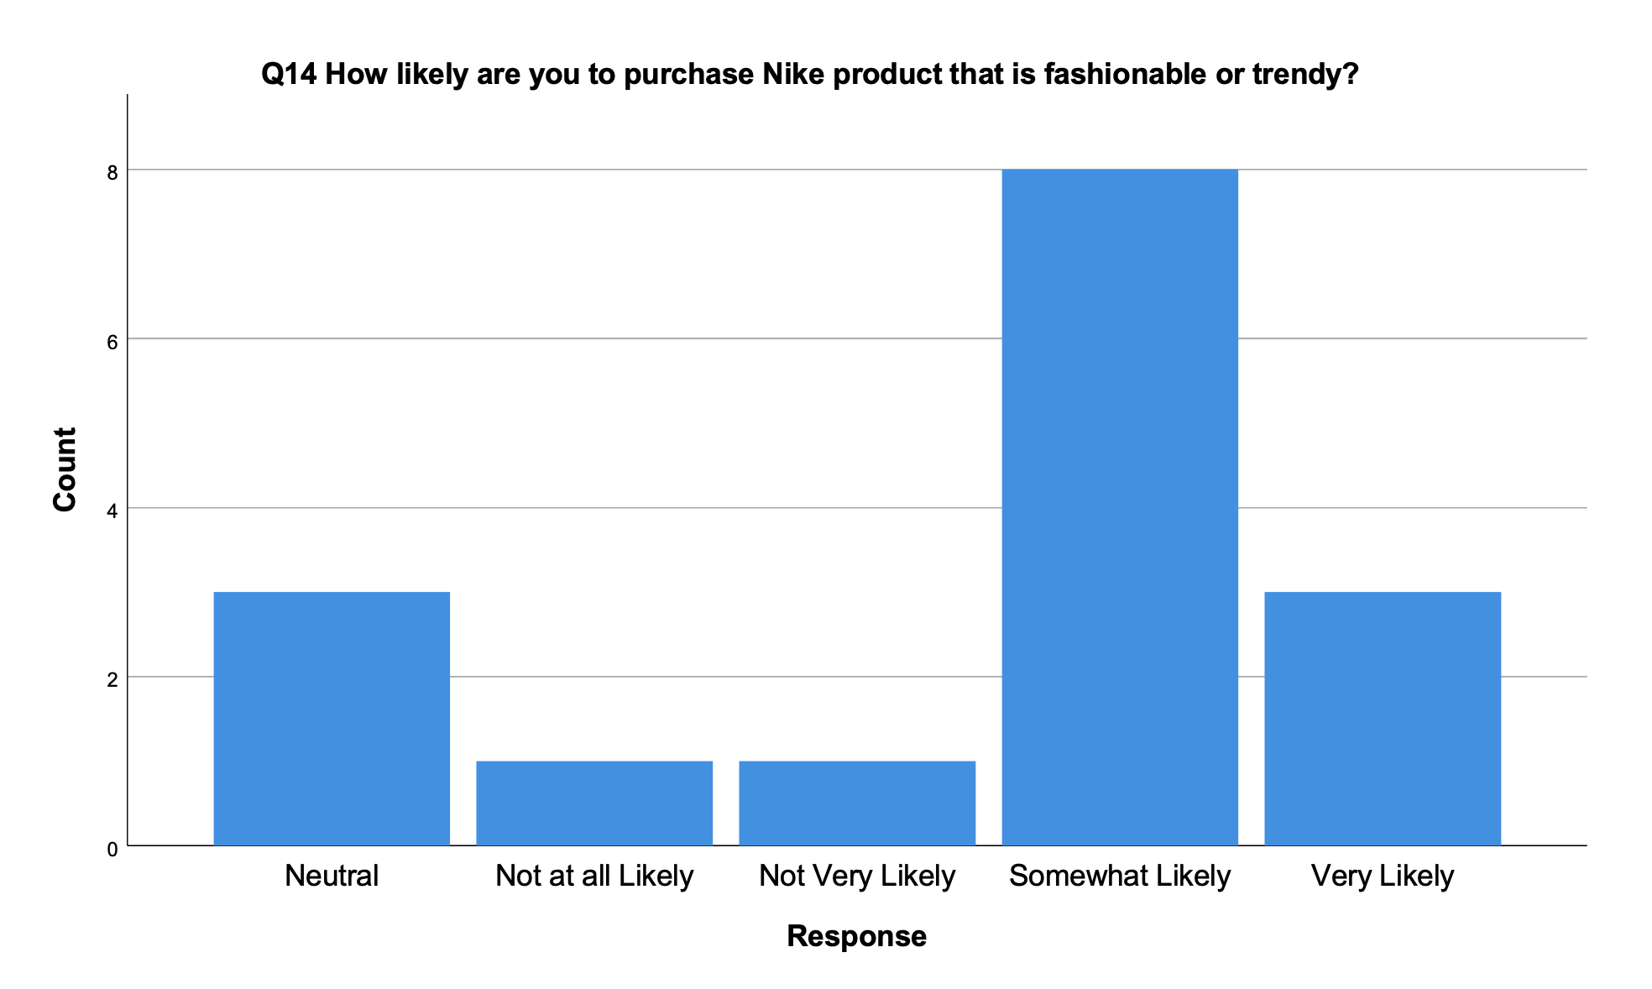
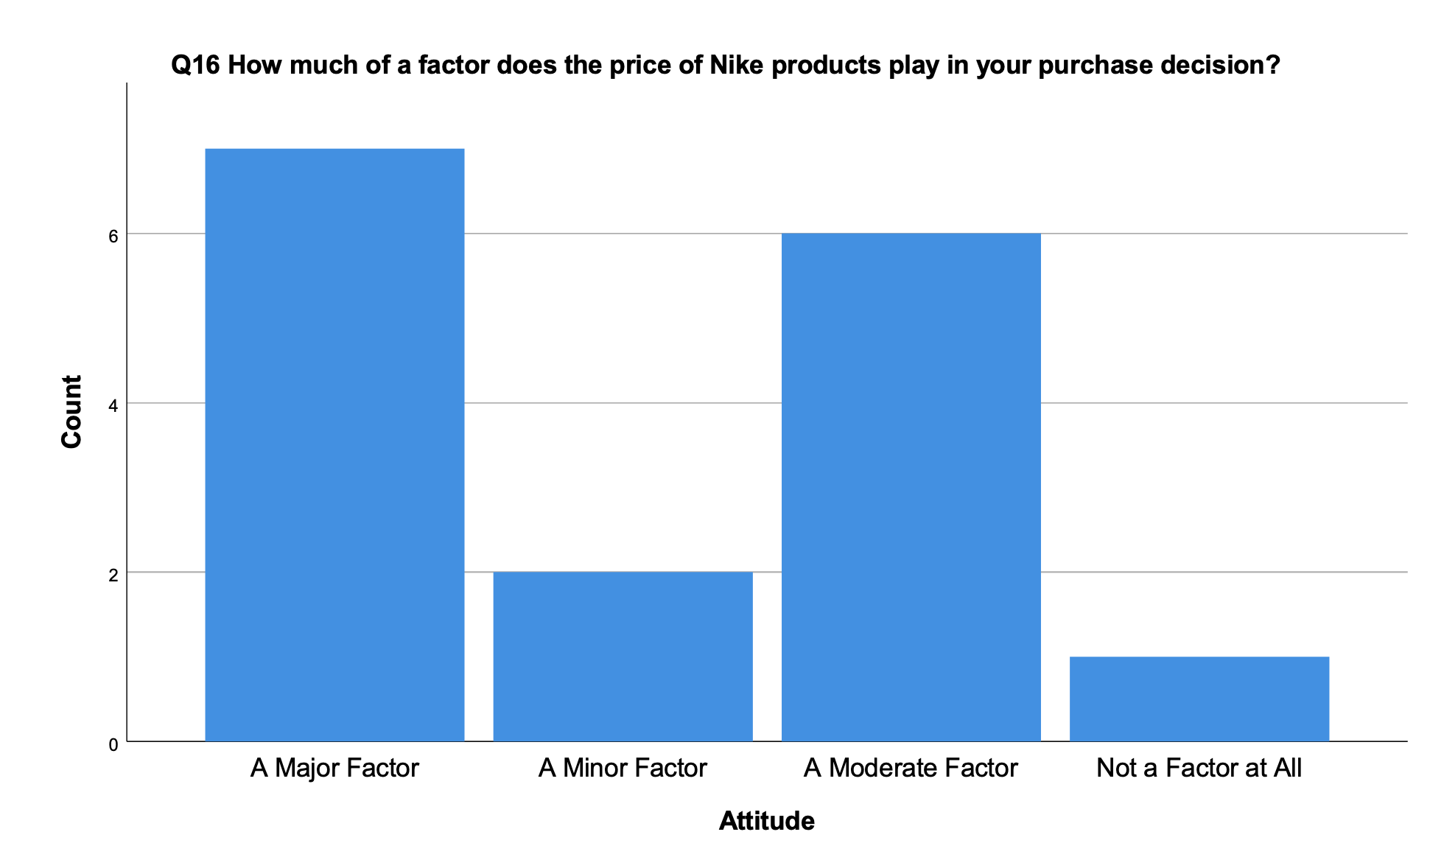
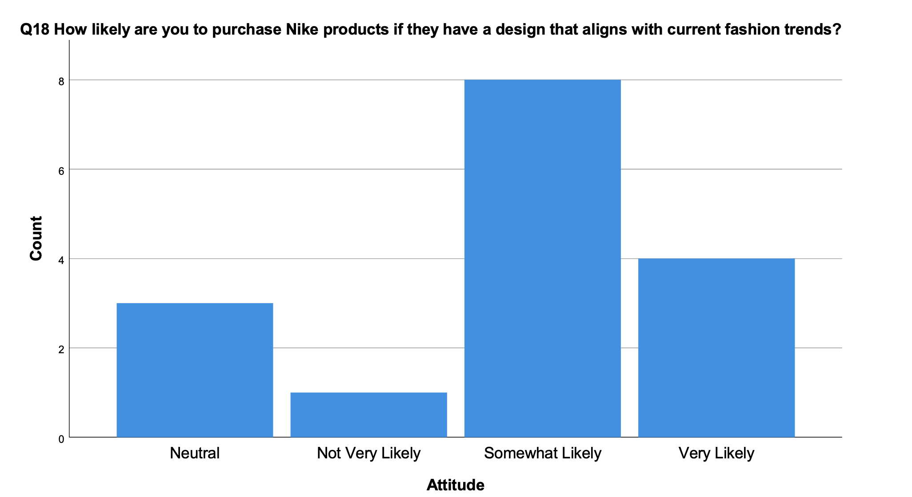
Graphs

Slide 8
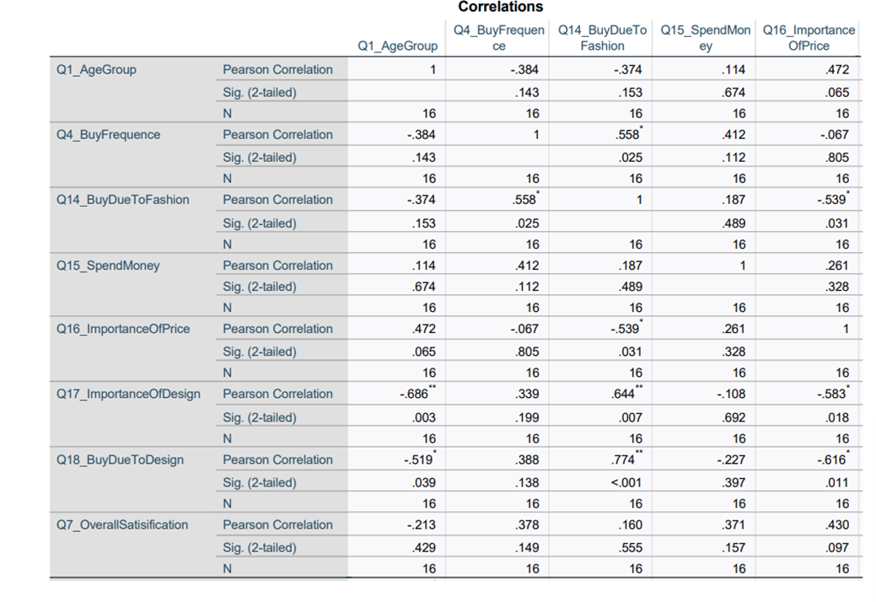
Statistical Methods-Pearson cofficient
•We observe a positive and negative correlation among the variables However, the correlation is not significant among the variables.
• The highest correlation observed among the variables is between buy due to design and overall satisfaction

Slide 9
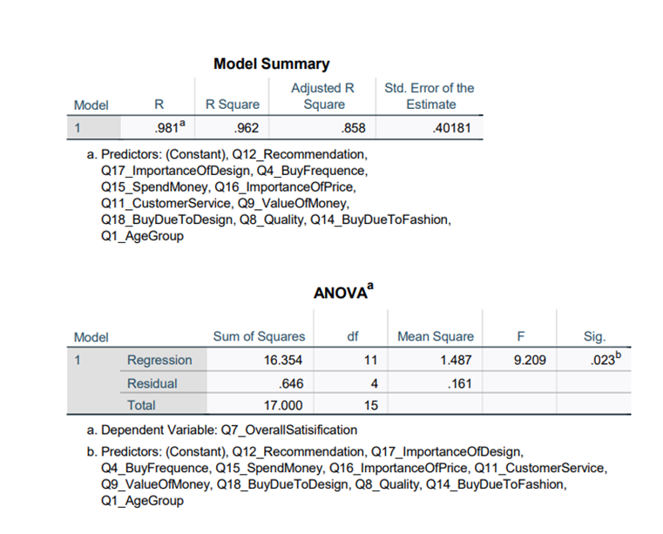
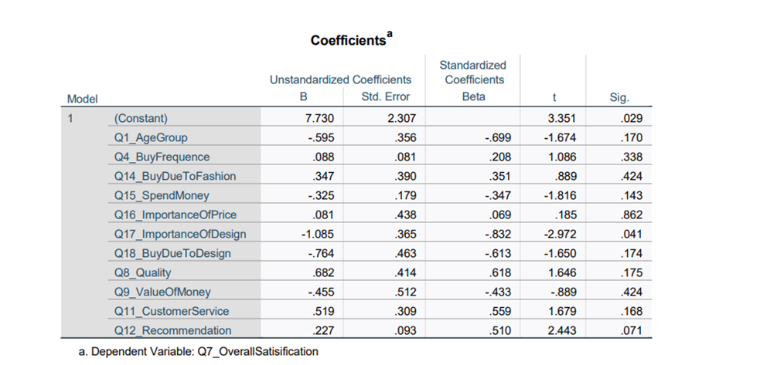
Statistical Methods-Linear regression
The R Square of 0.962 implies that it is a moderately effective model.
Significance level is 0.023and hence the relationship is significant.

Slide 10
Limitations
Limited data availability: The data available to researchers may be limited due to confidentiality concerns, proprietary information, or data privacy regulations. This could restrict the scope and depth of the research, as well as the accuracy of the findings.
Time constraints: Conducting thorough research takes time, and there may be a limited timeframe available to complete the project. This could lead to a rushed or incomplete analysis, potentially compromising the quality of the research.
Resource constraints: Conducting research can be costly, and there may be limited resources available to fund the project. This could limit the ability to collect comprehensive data, conduct extensive analysis, or hire specialized expertise.
Generalizability of findings: The findings of a research project may not be generalizable to other contexts or populations beyond Nike's products and markets. This could limit the usefulness of the research for other companies or industries

Slide 11
Conclusions
In conclusion, a Nike shoes and apparels research project has the potential to provide valuable insights into the company's operations, market position, and consumer preferences. However, the project may face limitations in terms of data availability, time and resource constraints, ethical concerns, and generalizability of findings. Nonetheless, by addressing these limitations and conducting thorough and well-designed research, the project could yield valuable recommendations for Nike on how to improve its products, sustainability practices, marketing strategies, and global reach. Ultimately, the success of the research project will depend on the quality of the research design, the availability and accuracy of the data collected, and the rigor of the analysis conducted.

Slide 12
Recommendations
Increase investment in sustainable materials and production processes: Nike should prioritize the development and use of sustainable materials and production techniques that reduce the environmental impact of its operations. This could include the use of recycled materials, biodegradable fabrics, and renewable energy sources in manufacturing.
Improve supply chain management and labor practices: Nike should take steps to improve supply chain management and labor practices to ensure the ethical treatment of workers and reduce the risk of supply chain disruptions. This could include increasing transparency and accountability in its operations, enhancing worker safety, and improving labor conditions in overseas factories.
Expand product lines and target new markets: Nike should consider expanding its product lines and targeting new markets to diversify its revenue streams and reach new consumers. This could include expanding its presence in emerging markets, developing new products for underrepresented sports segments, and targeting younger or more environmentally conscious consumers.
Incorporate technology into products and marketing strategies: Nike should continue to incorporate technology into its product designs and marketing strategies to enhance product functionality, improve consumer engagement, and differentiate itself from competitors. This could include the integration of wearable technology in products, leveraging data analytics to understand consumer preferences and trends, and developing personalized marketing campaigns.
Strengthen brand reputation and engagement: Nike should focus on strengthening its brand reputation and engagement with consumers through targeted marketing campaigns, partnerships with high-profile athletes and celebrities, and engagement with consumers on social media platforms. This could help differentiate Nike from competitors, increase brand loyalty, and drive sales.

Slide 13
References

Slide 14
Thankyou

